Slide 1







Increase Participation
Jessica Clarke
Arielle Daskal
Jack Hedrick
Brian Wild
Understanding the participation of the City of Boulder and CU Students
Notes:
Jack

Slide 2


CU Students
How can public participation in the City of Boulder be increased?
Notes:
Jess

Slide 3




Stakeholders
CU Boulder Students
Undergraduate
Graduate
TAs
Notes:
Jack

Slide 4

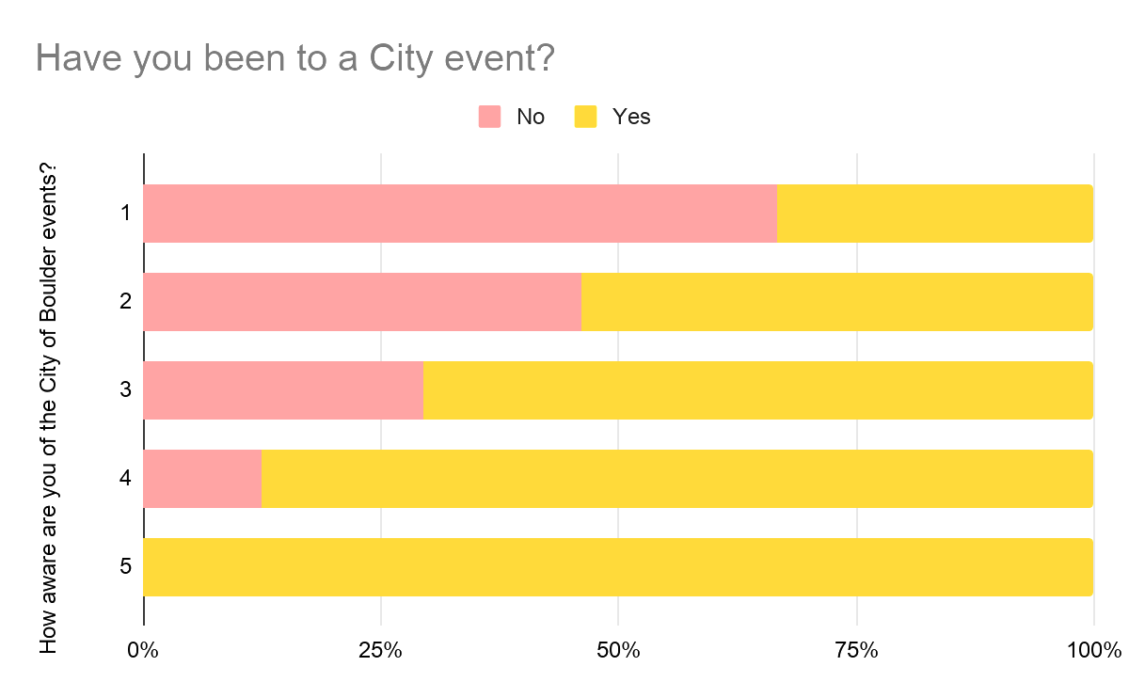


107,125
25,026
23%
Boulder population as of 2017
undergraduate students
of Boulder’s population is from CU
https://www.colorado.edu/oda/sites/default/files/attached-files/overallprofilefall19.pdf
Notes:
Jess

Slide 5


How often, and in what ways, do CU students participate with the CoB?
To understand our research question we need to understand the ways in which CU students currently participate with the community, and see where they lack.
Notes:
Jess

Slide 6

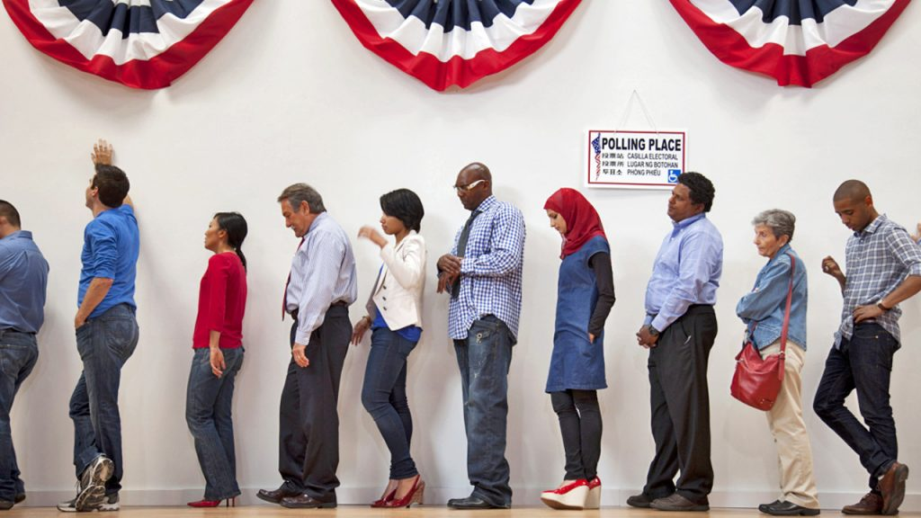
Why do we need to focus on the college presence in Boulder?
A Quarter of the Population
Every Vote Counts
Nearly a quarter of the population of Boulder are students at CU Boulder
The student population is relatively undereducated and feels undervalued by the City of Boulder
Notes:
Jess

Slide 7



Design & Research
How do CU students participate with the city?
Notes:
Arielle

Slide 8
Data Collections
Surveys
Observations
Interviews
Created a open ended survey with 12 questions
Uploaded the survey on reddit, sent it to friends and social media.
We received 46 responses
We each interviewed two students from CU Boulder
Codes and groupings were created so we could analyse the data
We have 8 interviews altogether
We each observed one City of Boulder event
Codes and groupings were created so we could analyse the data
We have 4 observations all together
Notes:
Arielle

Slide 9

Data Findings
Surveys
Interviews & Observations
People found out about City of Boulder events mostly from word of mouth and friends.
The people in Boulder seem to be happy with the transportation system and unhappy with public safety.
People would want to hear about Boulder events, but the advertising for it is lousy.
People in Boulder are very friendly
People in Bouler are unhappy with the homeless people
Students at CU Boulder feel undervalued
Lack of interest in CoB stationary advertising
There is a lack of education about CoB operations and practices
Notes:
Arielle

Slide 10
“So like, I know what's going on at CU, but I don't
know what's going on in Boulder as a whole because they only
hear about what's going on at CU. Yeah.”
CU Students are constantly swamped with CU news. Integrating Boulder news within that would increase awareness.

Slide 11

Where do students learn about City of Boulder events and opportunities?
While 20% of student respondents reported they had not heard of any community events, 55.6% received information through word of mouth from family and friends
Notes:
Jack

Slide 12
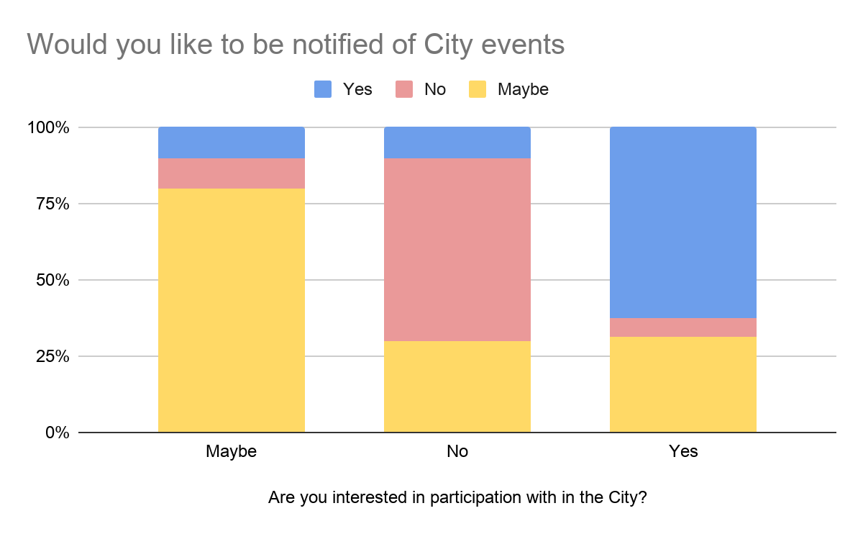
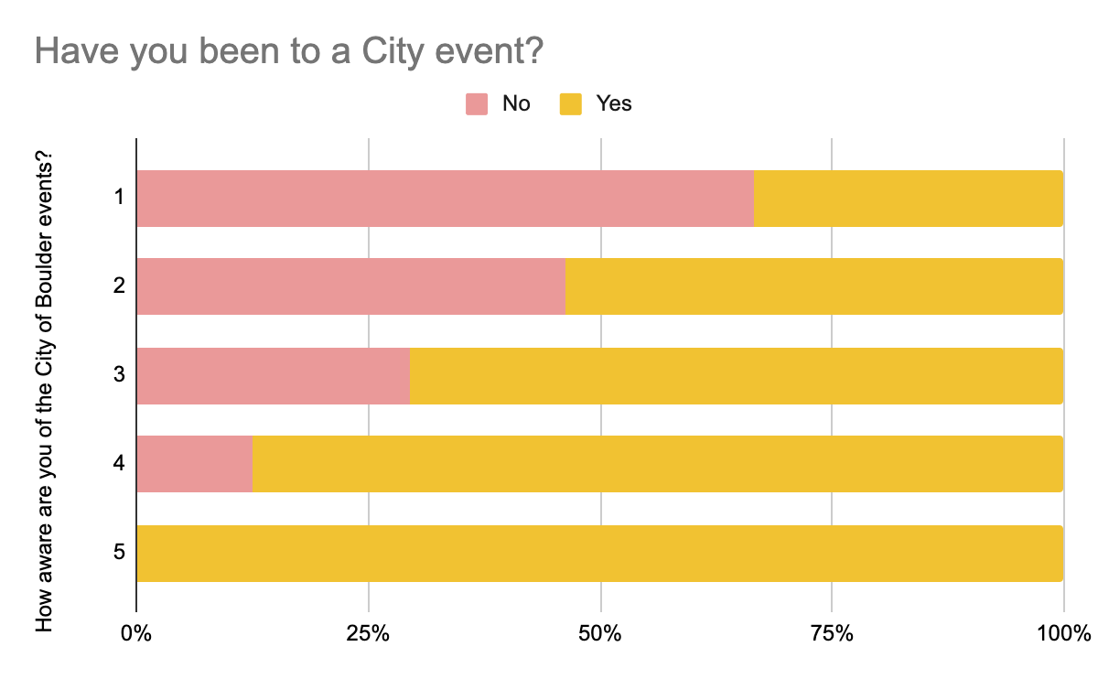
Survey data
Notes:
Arielle

Slide 13



Solutions
What would we suggest to increase the participation/ awareness of CU students to their city.
Notes:
Jack

Slide 14

Communication
How can student involvement be increased?
Marketing
Student Club
The CU campus is a hot-bed of untapped under informed participants
Brochures and pamphlets only account for 20% of information delivery, public transportation would offer greater exposure
Student organizations serve to inform students and so could be a valuable step in the word-of-mouth process
Notes:
Brian

Slide 15

Communication
Current Participants
New Participants
The city should identify current participants from CU Boulder, these participants inform new participants
The city should seek to maintain new participants, and encourage them to attract other potential participants
Notes:
Brian

Slide 16
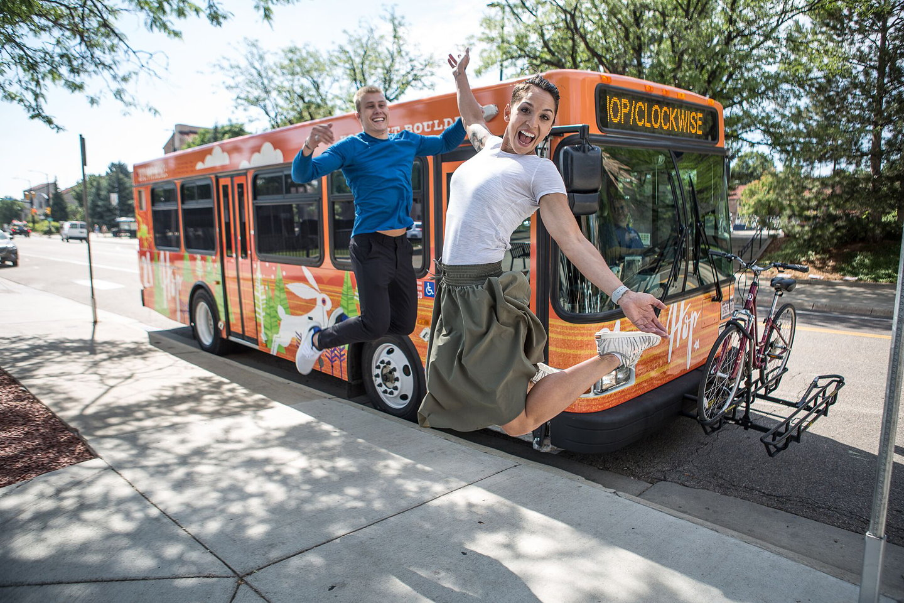

Marketing
Brochures & Pamphlets
Public Transportation
CoB stationary is often ignored and ineffective
Public transportation, primarily buses, are common fixtures throughout Boulder and so an excellent outreach opportunity
Notes:
Brian

Slide 17



Marketing and Visualizations
Social Media News
Public Transportation
By adding snippets of events in Boulder into CU news.
89% of survey respondents indicated they use public transportation, this provides the city an excellent education opportunity
Notes:
Brian

Slide 18
Student Run organization
By introducing a student club to CU that is aimed at increasing awareness within city politics, city regulations, and even city events. Through this our goal is to bring the city close with its student population, and increasing awareness/ participation with the city.
Notes:
Jess

Slide 19
Thanks!
Presentatino design by Slidesgo.com

